Slide 1

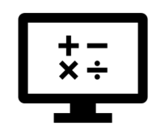
Graphing
Where do I find MATLAB? Here!
Do I have to have MATLAB installed on my computer right now? No, you can use MATLAB Online!

Slide 2

Table of Contents
What we cover last week (Week 4: Input/Output)
Interactive Plotting
Plotting the data
Controlling the Plot View
Property Inspector
Formatting Plots
Exporting to Another Application
What we've covered this week in Part 1
MATLAB Live Script

Slide 3
What we covered last week (Week 4: Input/Output)
Last week we learnt about:
Importing data from various structured data types
Processing data using live tasks
Importing data from unstructured data types

Slide 4
Interactive Plotting
When exploring data sets, it's helpful to visualize the data in different ways. You might want to use an area chart to visualize the difference between two series, or a scatter plot to visualize correlation. In MATLAB you can plot your data interactively using the Plots tab or programmatically using the MATLAB built-in functions for different plot types. We’ll start by learning how to plot interactively.

Slide 5
Plotting the data
In Week 4: Input/Output you learnt how to import data into MATLAB. Once you’ve imported your data, you might want to visualize it. In MATLAB you can create a plot from variables in the base workspace as follows:
Select the variables in the Workspace browser.
Select the Plots tab in the toolstrip. Some common plot types, suitable for the selected data, are listed.
Hover over any of the plot buttons to bring up more information on that type of plot.
Click on the desired plot icon to make the plot.
You can plot subsets of your data by first selecting a portion of a variable displayed in the Variable Editor.

Slide 6
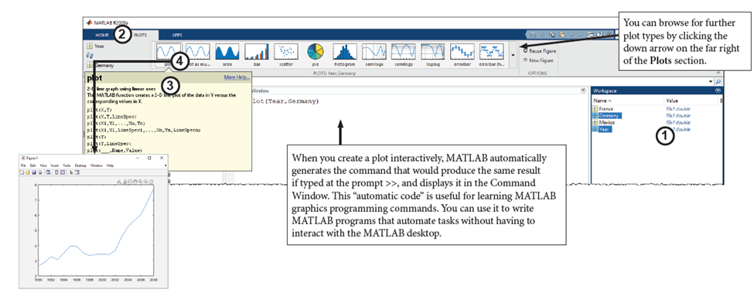
Plotting the data

Slide 7


Plotting the data
Let’s create a plot using the Plots tab.
AuDeMx is a mat file containing historical data of annual retail gasoline prices, in US dollars per gallon, for Australia, Germany, and Mexico from 1990 to 2008.
%Load the mat file
load AuDeMx
In the workspace you’ll see that there are 4 variables: Australia, Germany, Mexico, and Year, use the Plots tab to plot the Mexico data as a function of Year using the 4 steps outlined above.

Slide 8
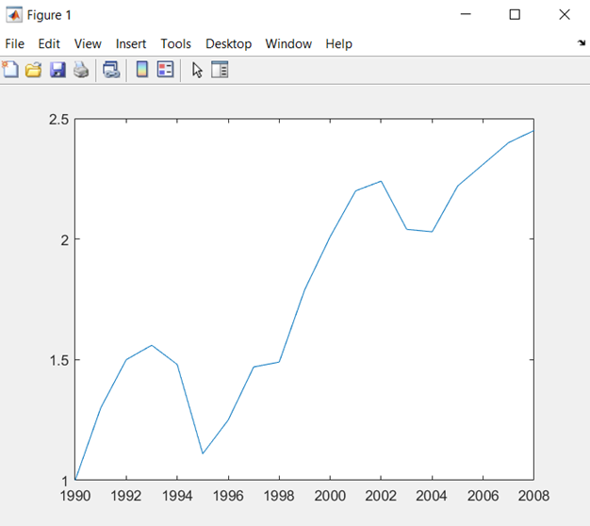
Plotting the data
Does your plot look like the below figure?

Slide 9
Controlling the Plot View
There are several tools to interactively explore and change the view in a plot. These tools automatically appear when the mouse approaches the upper-right corner of an axis. With these tools you can zoom, pan, and reset the plot view. These tools are toggled on/off when clicked and are controlled using the mouse (click to zoom in a fixed amount, click and drag to zoom-in to a region, etc.)
Tools that do not require interactive input, such as adding a legend, are available as buttons along the top of the figure.

Slide 10
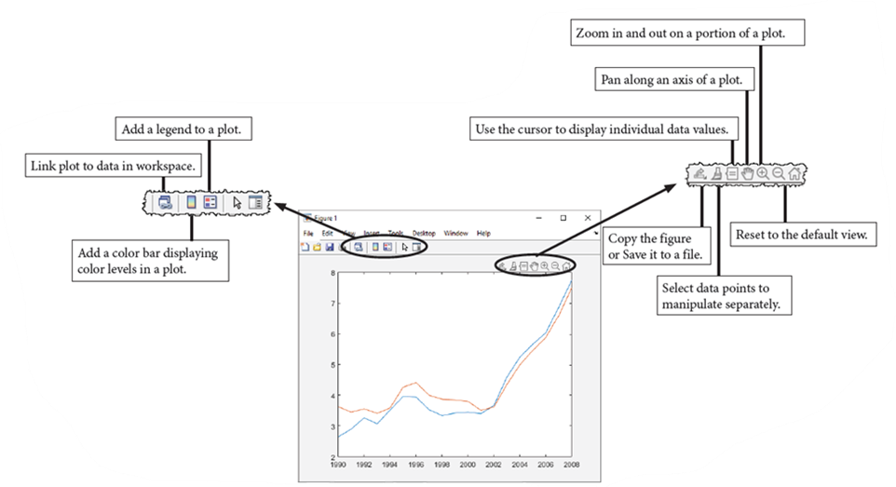
Controlling the Plot View
Tools that do not require interactive input, such as adding a legend, are available as buttons along the top of the figure.
Experiment with zooming in and out of your plot. Use the tools to reset the original view.

Slide 11
Property Inspector
You can format the plot so that it conveys exactly the information you want. The Property Inspector button at the top of any MATLAB figure window opens a list of the properties of objects in a plot. You can use the Property Inspector to view and edit these properties.
The Property Inspector includes:
An expandable menu to select the object you are editing
A search bar to quickly find properties
Fields to view and edit property values
Categories of properties

Slide 12
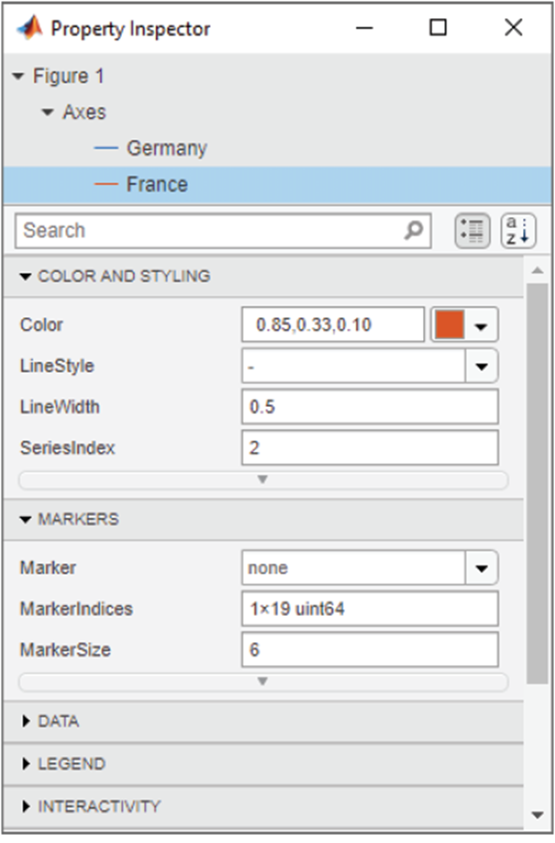
Property Inspector
To edit the properties of the specific elements (figure, axes, line, etc.), clicking on the appropriate part of the graph will show the appropriate properties. If you add a new item such as a label, the Property Inspector shows the properties for this new item. You can click on another item or use the menu to change to another item.
Open the Property Inspector interface for your plot of the gasoline price data. Click the line representing gas prices in Australia to see its properties.

Slide 13
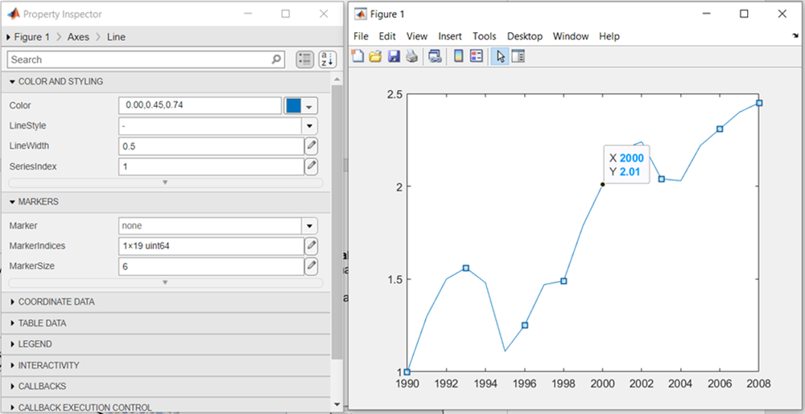
Property Inspector
You should see the properties below.

Slide 14
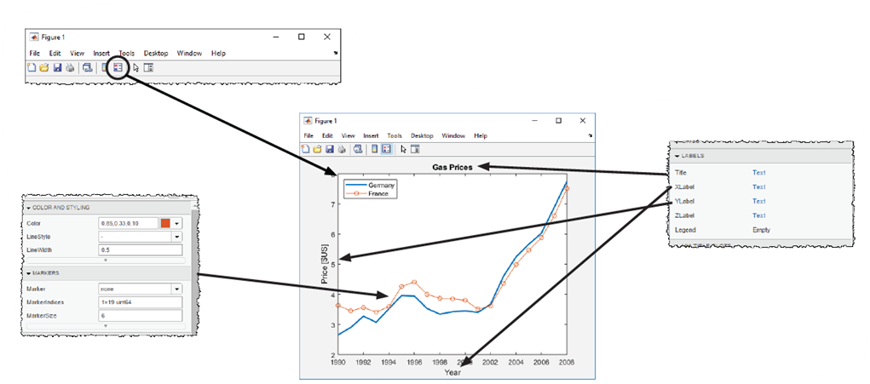
Formatting Plots
You can add a title and labels to the plot by selecting the axes and examining the Labels properties. Grids lines may be added and modified through the Grids properties, and the tick marks for the x and y axes can be controlled from the Ticks properties.
By selecting a line object, you can specify the style, color, and size of the markers and lines.

Slide 15
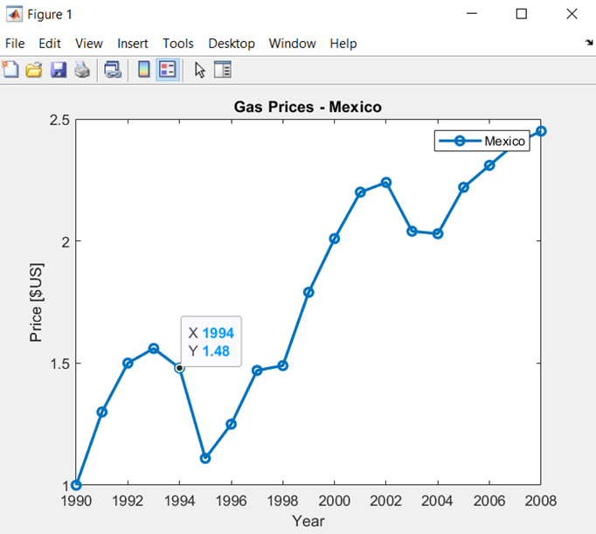
Formatting Plots
Let’s format the Mexican gasoline price data figure:
Select the axes and add an XLabel, YLabel, and Title to the graph.
Add a legend to the graph (You can edit the legend by double-clicking the text in the legend box).
Select the line representing Mexico and add circle data markers.
Select the line representing Mexico and change the line width to 2.

Slide 16
Exporting to Another Application
You can save, copy, and export MATLAB figures to applications such as word processors, presentation software, and Web pages.
You can save a figure as an image by selecting the export icon in the upper-right corner of the axes and choosing the first icon in the drop-down menu.
By selecting the second or third icon you can copy the figure. The second icon copies the figure as an image while the third copies it as a vector graphic.
By selecting File > Save as from the menu at the top of the figure window, you can save the figure as a .fig file. The .fig format is a binary format specific to MATLAB. These files contain all the information about a figure, including the data, property settings, annotations, etc. You can therefore open figures saved in this format and continue working with them in MATLAB.

Slide 17
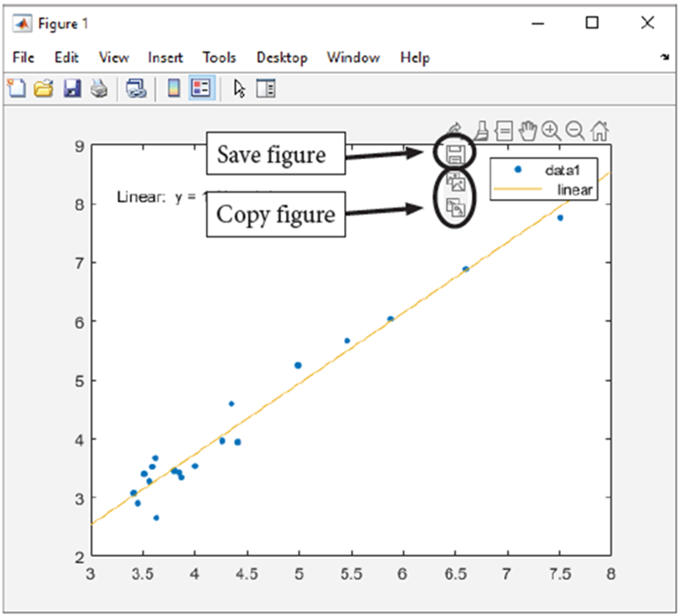
Work with Input Data Interactively

Slide 18
What we've covered this week in Part 1
This week in Part 1 we learnt about:
Interactively plotting data
Interactively controlling the plot view
Property inspector
Interactively formatting plots
Interactively exporting to another application

Slide 19
MATLAB Live Script
Click on the link below for this lecture’s MATLAB live Script
Week_5_Part_1_Functions_and_Graphing.mlx
Copyright 2022 The MathWorks, Inc. & Opti-Num Solutions (Pty) Ltd.

